Slide 1
Select Slides for PEM
From past presentations by
Colin Chisholm RPF
Assistant Manager ALRF

Slide 2
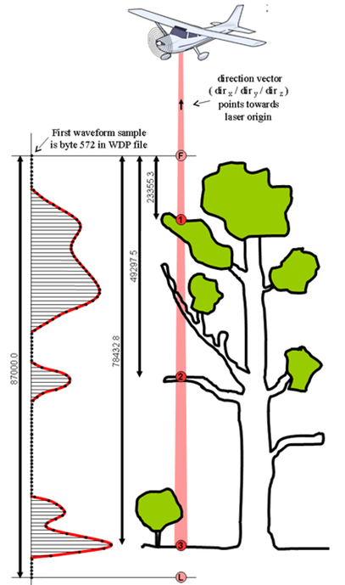
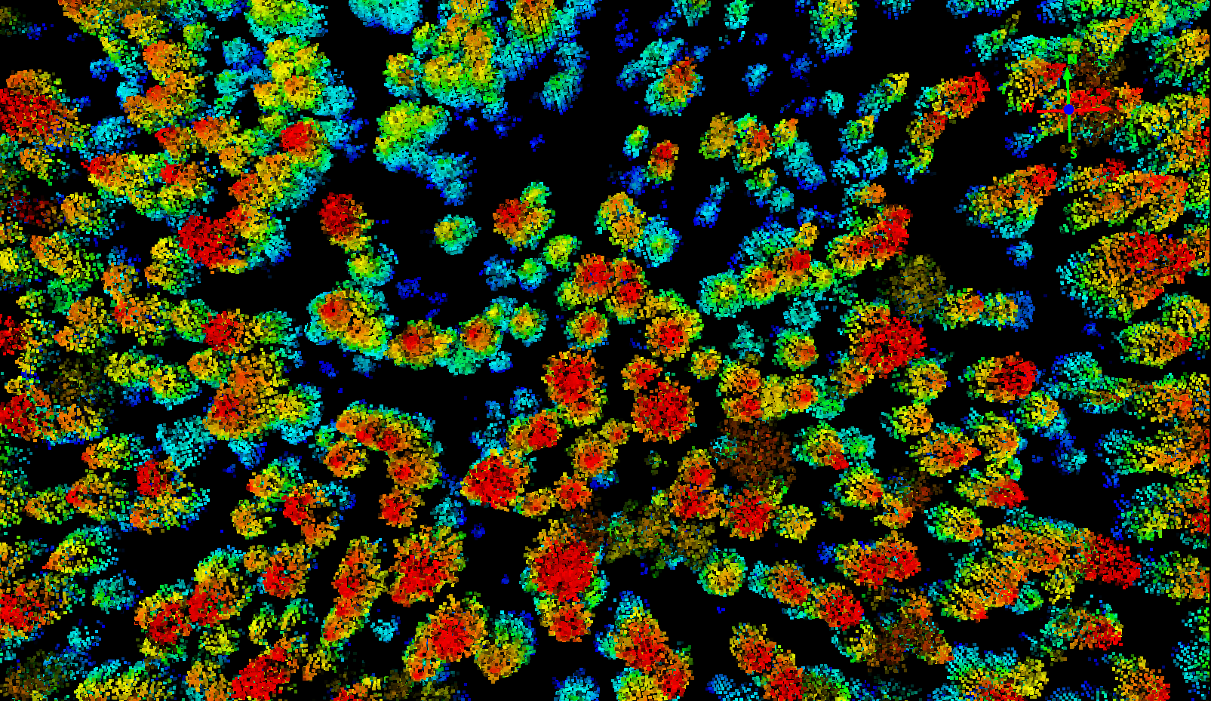
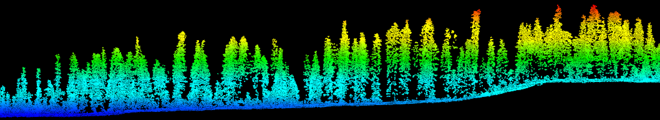
LiDAR / Aerial Laser Scanning (ALS)
Notes:
NEVER WHAT TO ASSUME
Quick Review – of What is LiDAR.?
Specifically ALS – Aerial Laser Scanning (the sensor mounted on an plane or helicopter – possibly a drone
Left image – lasers fired, multiple returns
Main image top down view of the forest stand – of course can be rotated
Standard Products / Models
Left is a high resolution terrain model
Right side is the canopy height model yellow youngest stands … or shortest
Ramping up through our tallest, highly productive, and older
Though not necessarily oldest stands

Slide 3
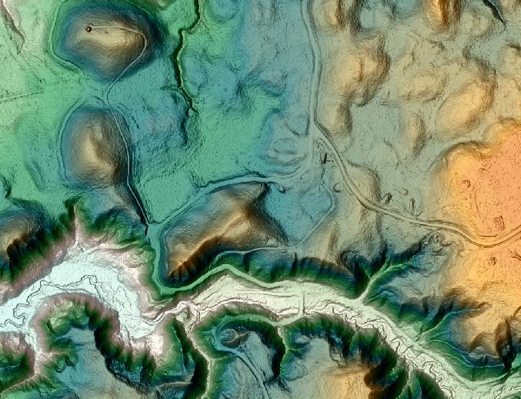
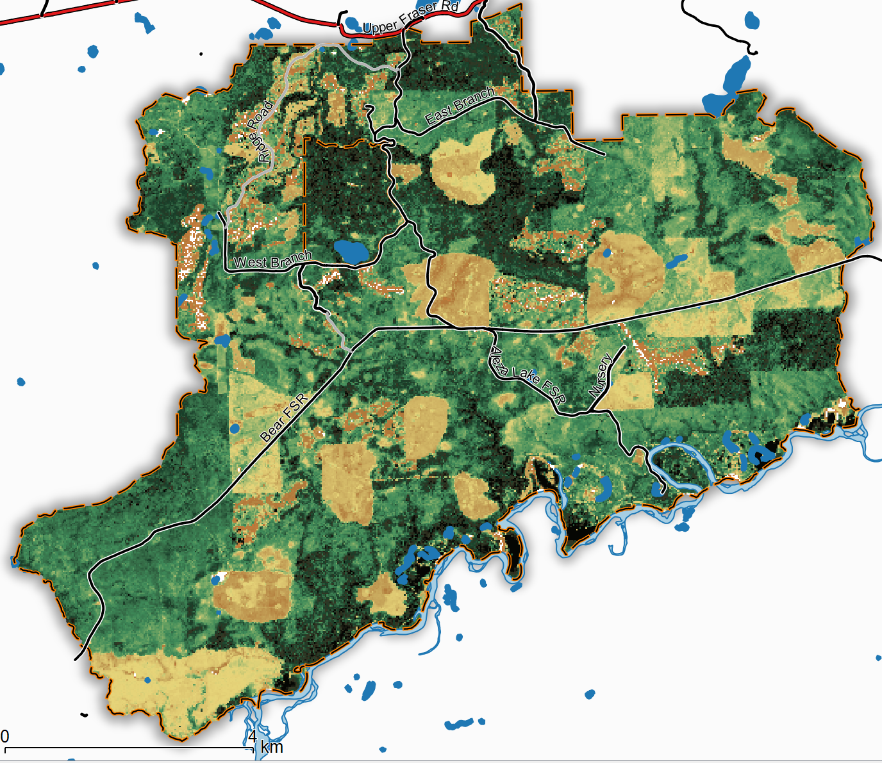
LiDAR / Aerial Laser Scanning (ALS)
Notes:
NEVER WHAT TO ASSUME
Quick Review – of What is LiDAR.?
Specifically ALS – Aerial Laser Scanning (the sensor mounted on an plane or helicopter – possibly a drone
Left image – lasers fired, multiple returns
Main image top down view of the forest stand – of course can be rotated
Standard Products / Models
Left is a high resolution terrain model
Right side is the canopy height model yellow youngest stands … or shortest
Ramping up through our tallest, highly productive, and older
Though not necessarily oldest stands

Slide 4
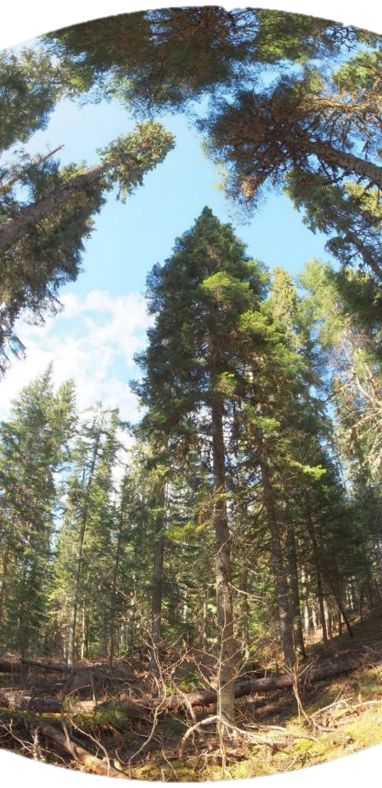
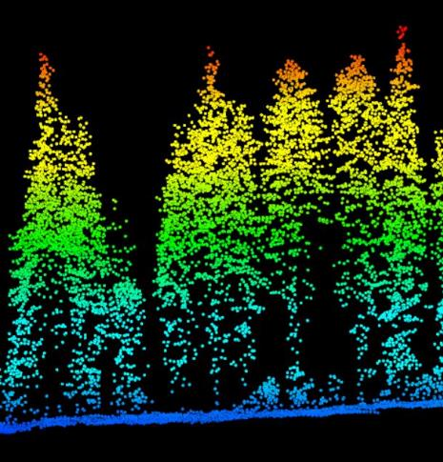
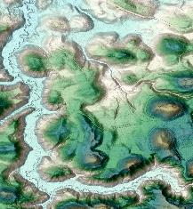
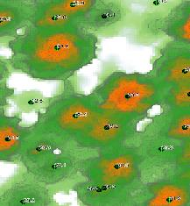
Models – Derived from ALS/LiDAR
Forest Stands
‘empirical data’
Digital Terrain Model
Canopy Height Model (Forest Stands)
Individual Tree Detection
Hydrology Models
Raw LAS Data
Informational
Models

Slide 5
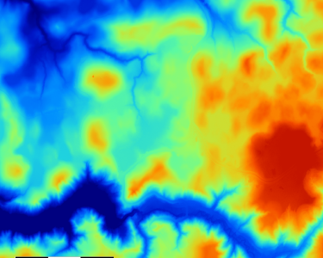
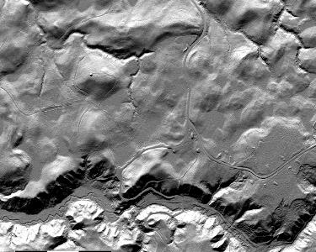
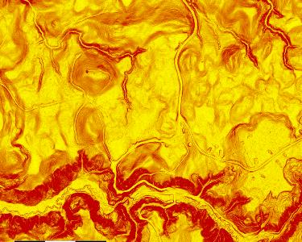
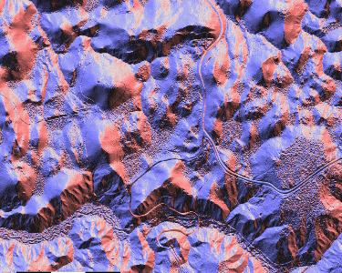
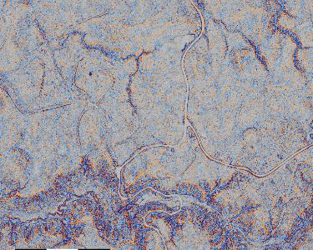
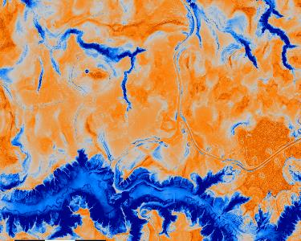
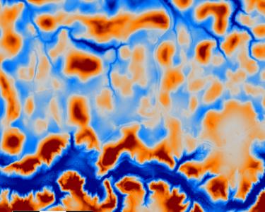
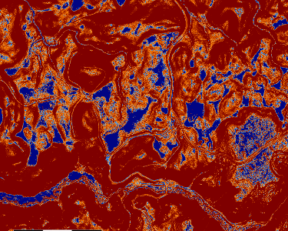
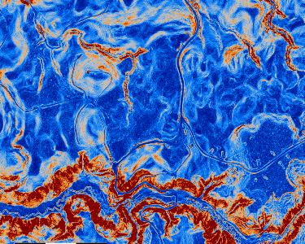
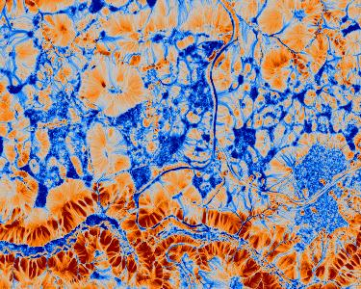
Update
Data Layers
Notes:
Top: Digital Elevation Model, Hillshade model
Middle: Slope, Aspect, General Curvature, Positive Openness
Bottom: Topographic Position Index, Multiresolution Index of Valley bottom flatness, Terrain Ruggedness Index, Topographic Wetness Index

Slide 6


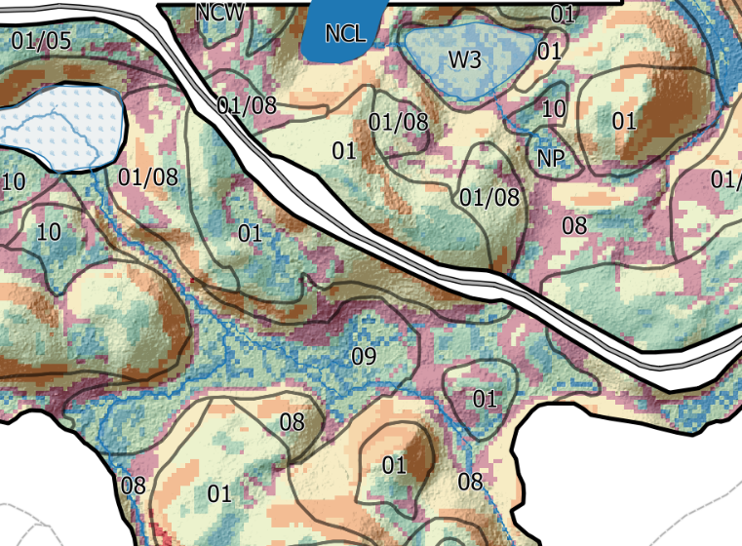

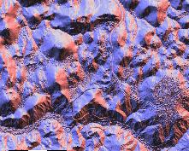
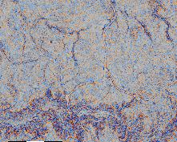
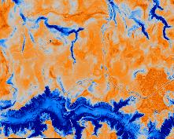
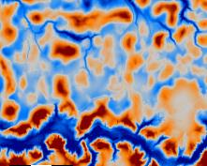
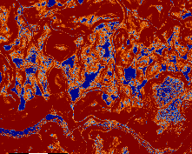
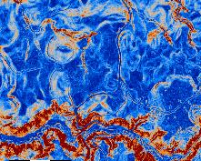

Predictive Ecosystem Mapping
Data Layers
Top: Elevation, Hillshade
Middle: Slope, Aspect, General Curvature, Positive Openness
Bottom: Topographic Position Index, Multiresolution Index of Valley bottom flatness, Terrain Ruggedness Index, Topographic Wetness Index
PEM: BEC Site Series
K-means Classification (colours)
Field Based site series stratification (from previous season)
Collaborative Project: FLNRORD, MOE, UNBC, TRU, UBC, ALRF
Notes:
LEFT: various layers derived from the 1m² DTM (LiDAR acquired)
RIGHT: 2 layers
Coloured based map K-means classified raster. The k-means method does groups the variability of the input layers. This is a first approximation of site series. Generally, orange and yellow tones are drier, salmon is toe slope, and green and blues are wetter.
Lines/polygons are the BEC SBSwk1 site series that were mapped the previous summer, before the generation of the k-means layer. What is amazing to me is that already without empirical training data is that the polygons and colour fit well together.
- Site series 01/05 and 01 are drier sites at Aleza, 08 tend to be rich moist sites. 09 and 10 are water receiving and often shallow to water-table sites.

Slide 7
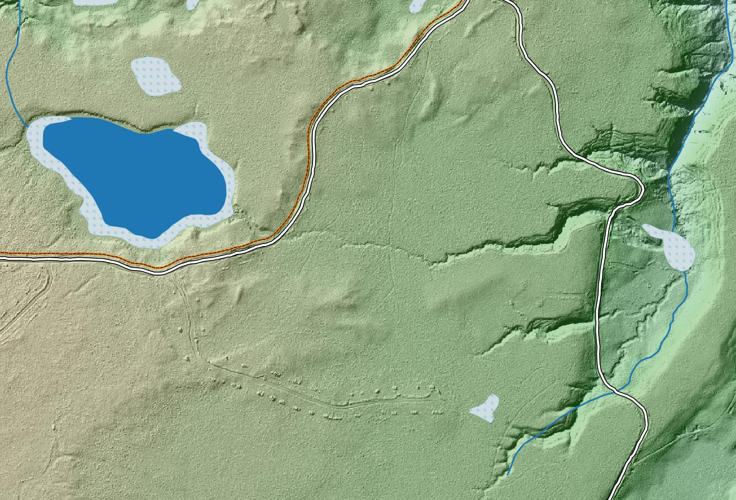
Aleza Lake RF – Hydrology
TRIM Streams Data
Notes:
From pretty pictures to Data Interpretation

Slide 8
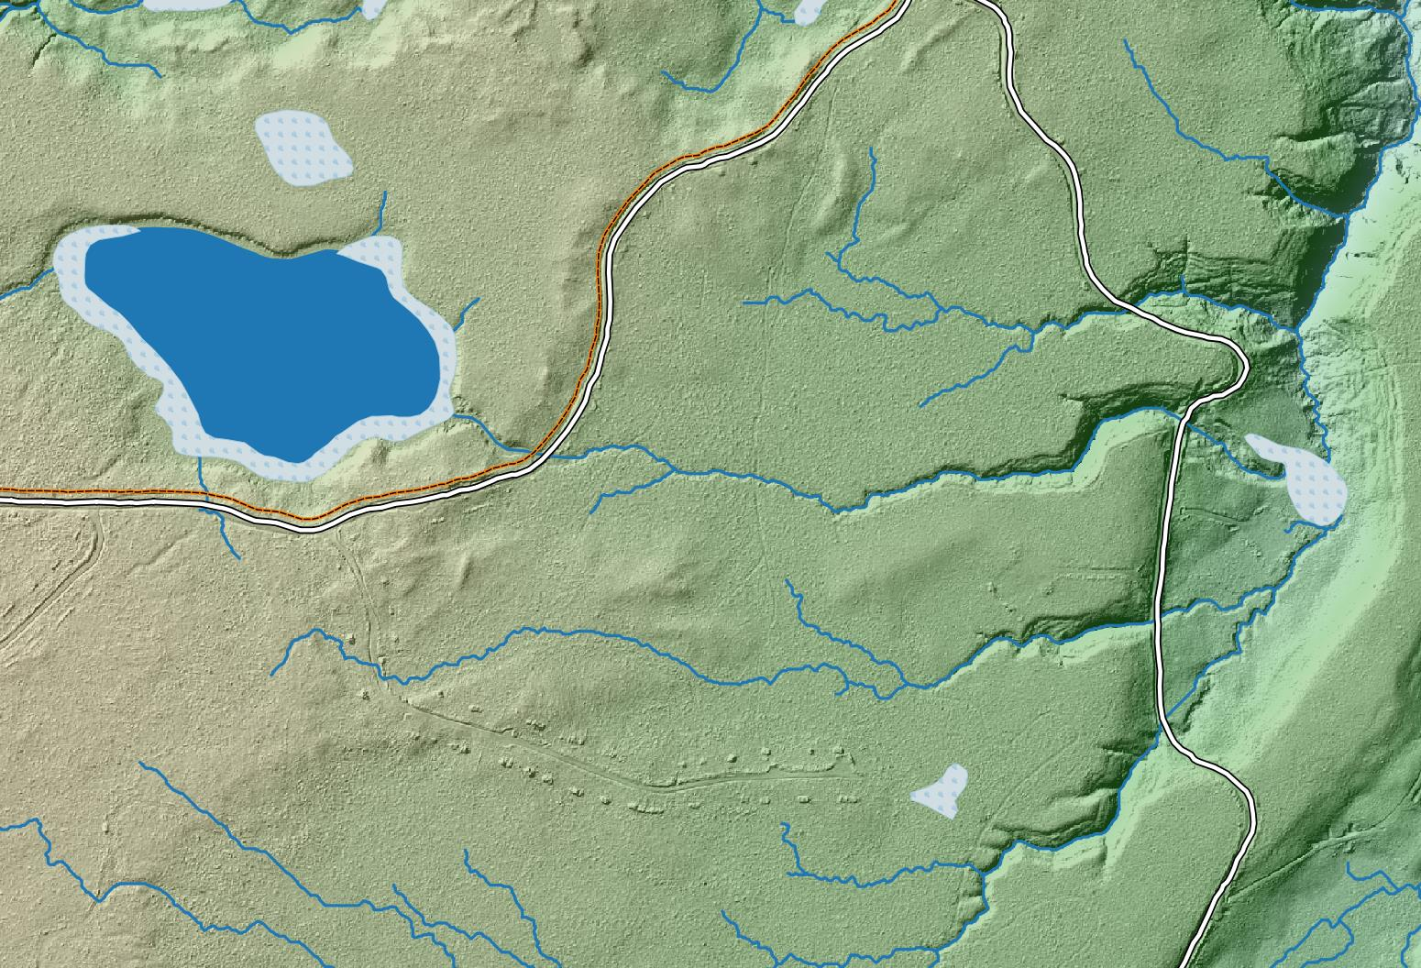
Aleza Lake RF – Hydrology
LiDAR DTM Analysis – auto-extraction of Streams and NCDs

Slide 9
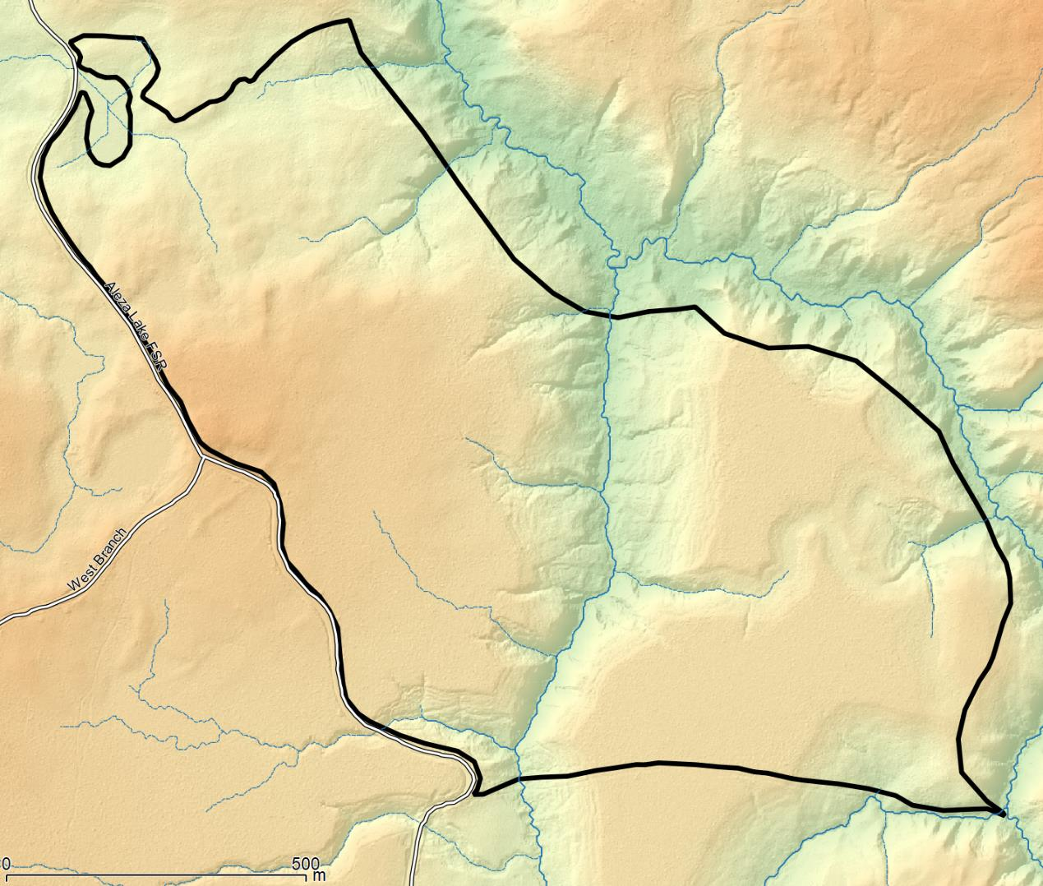
Stand Level Pre-Stratification of Site Series

Slide 10
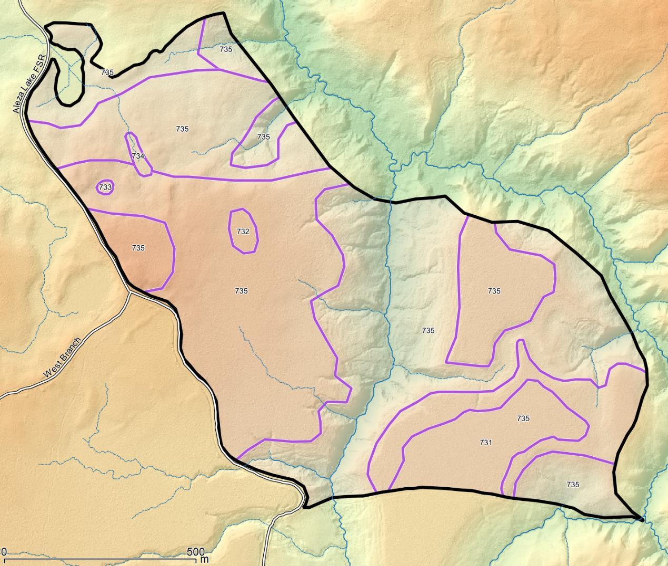
Stand Level Pre-Stratification of Site Series
Notes:
Next Steps – need to automate this
Note polygon numbers are not site series … just an ID

Slide 11
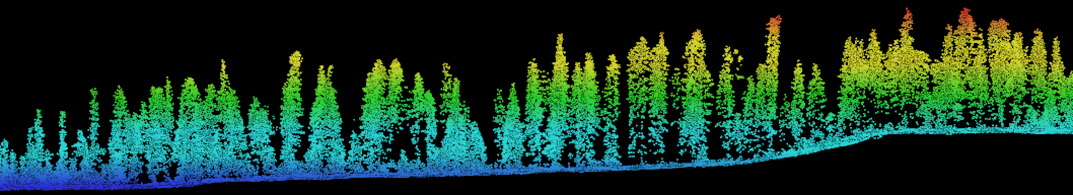


Aleza Lake Research Forest Considering Site Productivity presented by: Colin Chisholm RPF, MSc. Candidate for: PEM Methods Development – Spring 2018 March 13, 2018

Slide 12
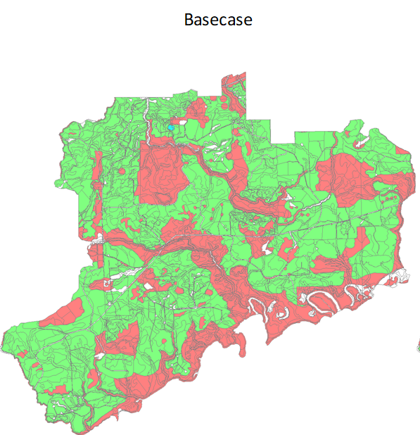
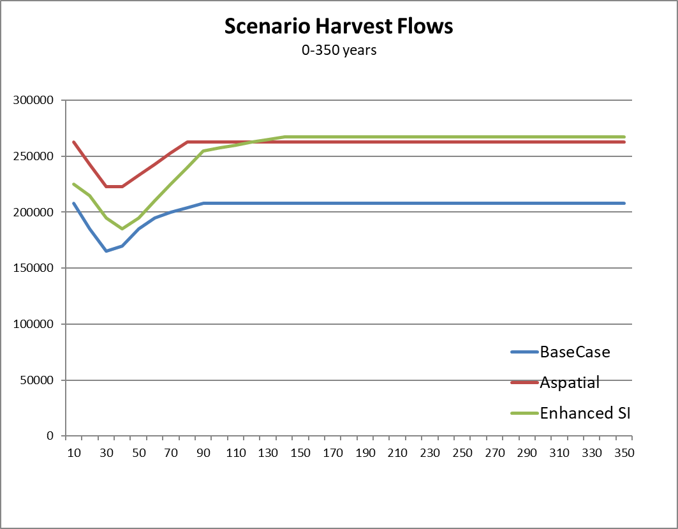
ALRF Timber Supply
THLB: 5,787ha.
Notes:
SI matters
Blue basecase is using PPL
Green is using 30% higher SI based on Field and LiDAR measurements … more research needed to confirm SI should be higher.

Slide 13
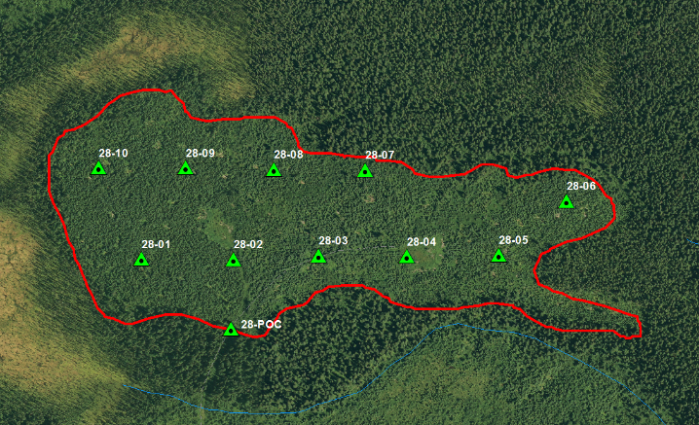
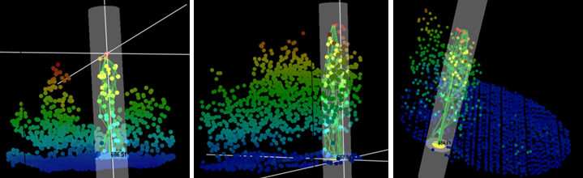
Site Productivity
Initially Examined with FUSION/ LDV
Measuring tree heights in the point-cloud
Screenshots form USDA’s Fusion/LDV

Slide 14
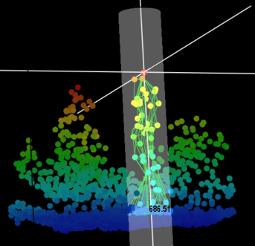
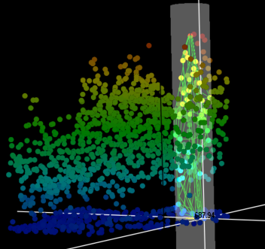
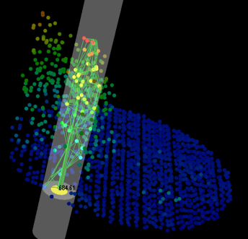
Site Productivity
 | LiDAR | Field
n | 16 | 16
max | 9.18 | 8.94
mean | 8.53 | 8.43
Min | 7.88 | 7.92
Stdev | 1.33 | 1.04
CI α =0.05 | 0.650 | 0.509
Site Index | 23.7 | 23.5
measuring tree heights in the pointcloud
Screenshots generated from USDA's Fusion LDV
Notes:
Site Index generated using ‘Site Tools’ with known species and known age of plantation establishment
AGES: Field was based on drill
LiDAR was based on RESULTS database (planting date)
This demonstrates that it works
But now – it can be used to across the entire block, or across the whole Landscape

Slide 15
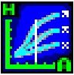
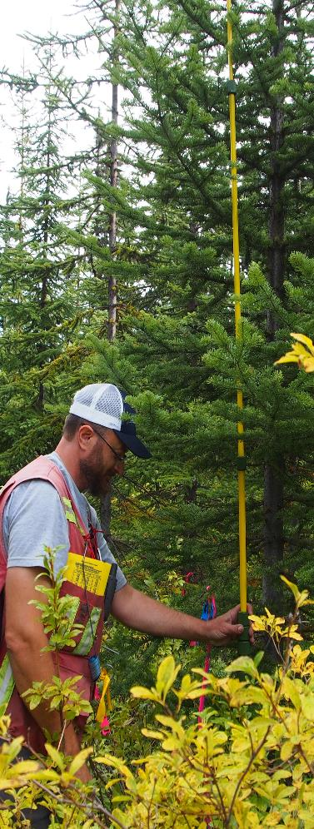
Site Productivity
ALS/LiDAR Area Based Approach 99%
Notes:
As opposed the previous slides – where height was derived by locating individual trees in the point cloud
This slide show how a LAS metric of p99 could be used to measure the stand height
Empirical data is for growth intercept data collected in the field input into ‘Site Tools’ with a known stand age and species.
RS data was a p99 LAS metric to estimate height, and using zonal statistics the median height for AOI was generated … this median height was used in Site Tools as above.

Slide 16
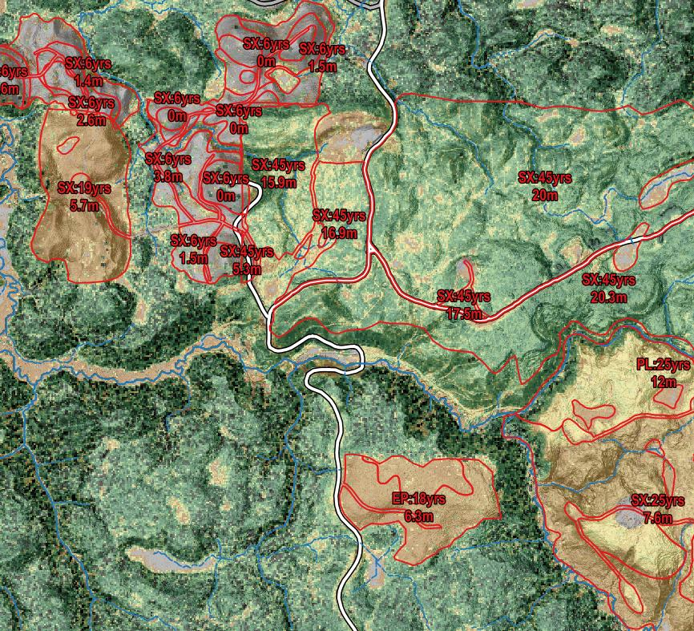
SiteTools Inputs
RESULTS Database
Historical Activities
Planting year and species
Survey Data
Stratified(?)
LiDAR Stand Height
Potential to associate LiDAR-PEM with Site Indices

Slide 17
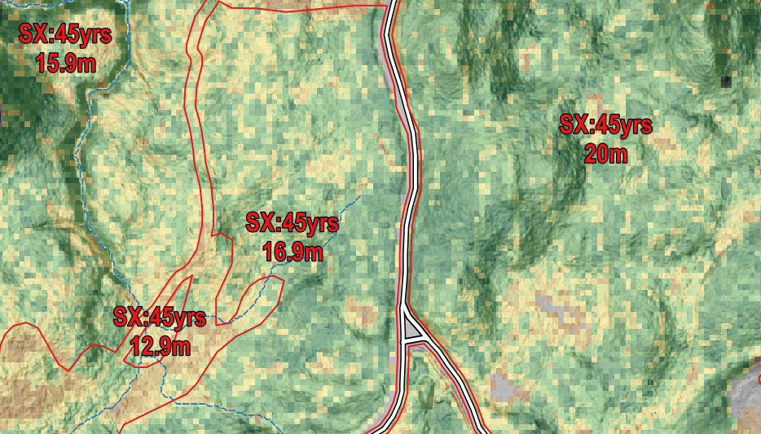
Discussion
Problem areas
Assumptions
PEM site series association
Notes:
Problem areas
Clear win with even aged / low retention stands
Difficulties with small patch or high retention areas.
Assumptions
GY Curves are a good representation of reality
Young stands: are we measuring site productivity or are we measuring genetic gain.
Climatic or Growing season influences Ecological processes driving SI
PEM can we use the ALS metrics to provide a metric of Site Productivity and then project that to unharvested sites?
Should a Productivity Layer be driven by the PEM OR

